Slide 1

A Better Professional You
Michael A Heroux

Slide 2
Some Thoughts on Time Management A Principles Approach
Michael A. Heroux
Scientist in Residence
Department of Computer Science

Slide 3
Time Multipliers
Commit some time to Important but not Urgent work.
Be done-done.
Leave breadcrumbs.
Engage in complementary multi-tasking.
Leave slack in your schedule.
Work with synergistic people.
How can we do this? Consider Kanban.

Slide 4
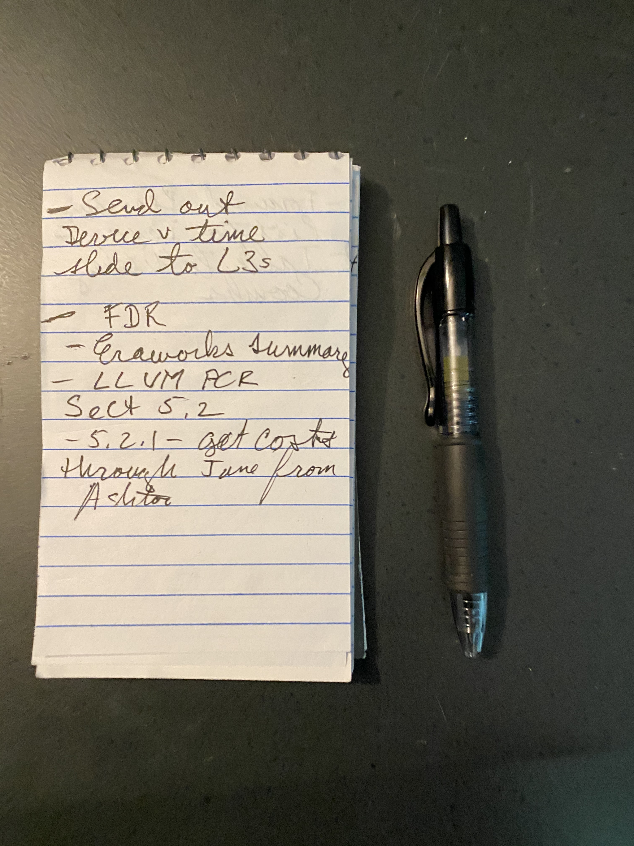
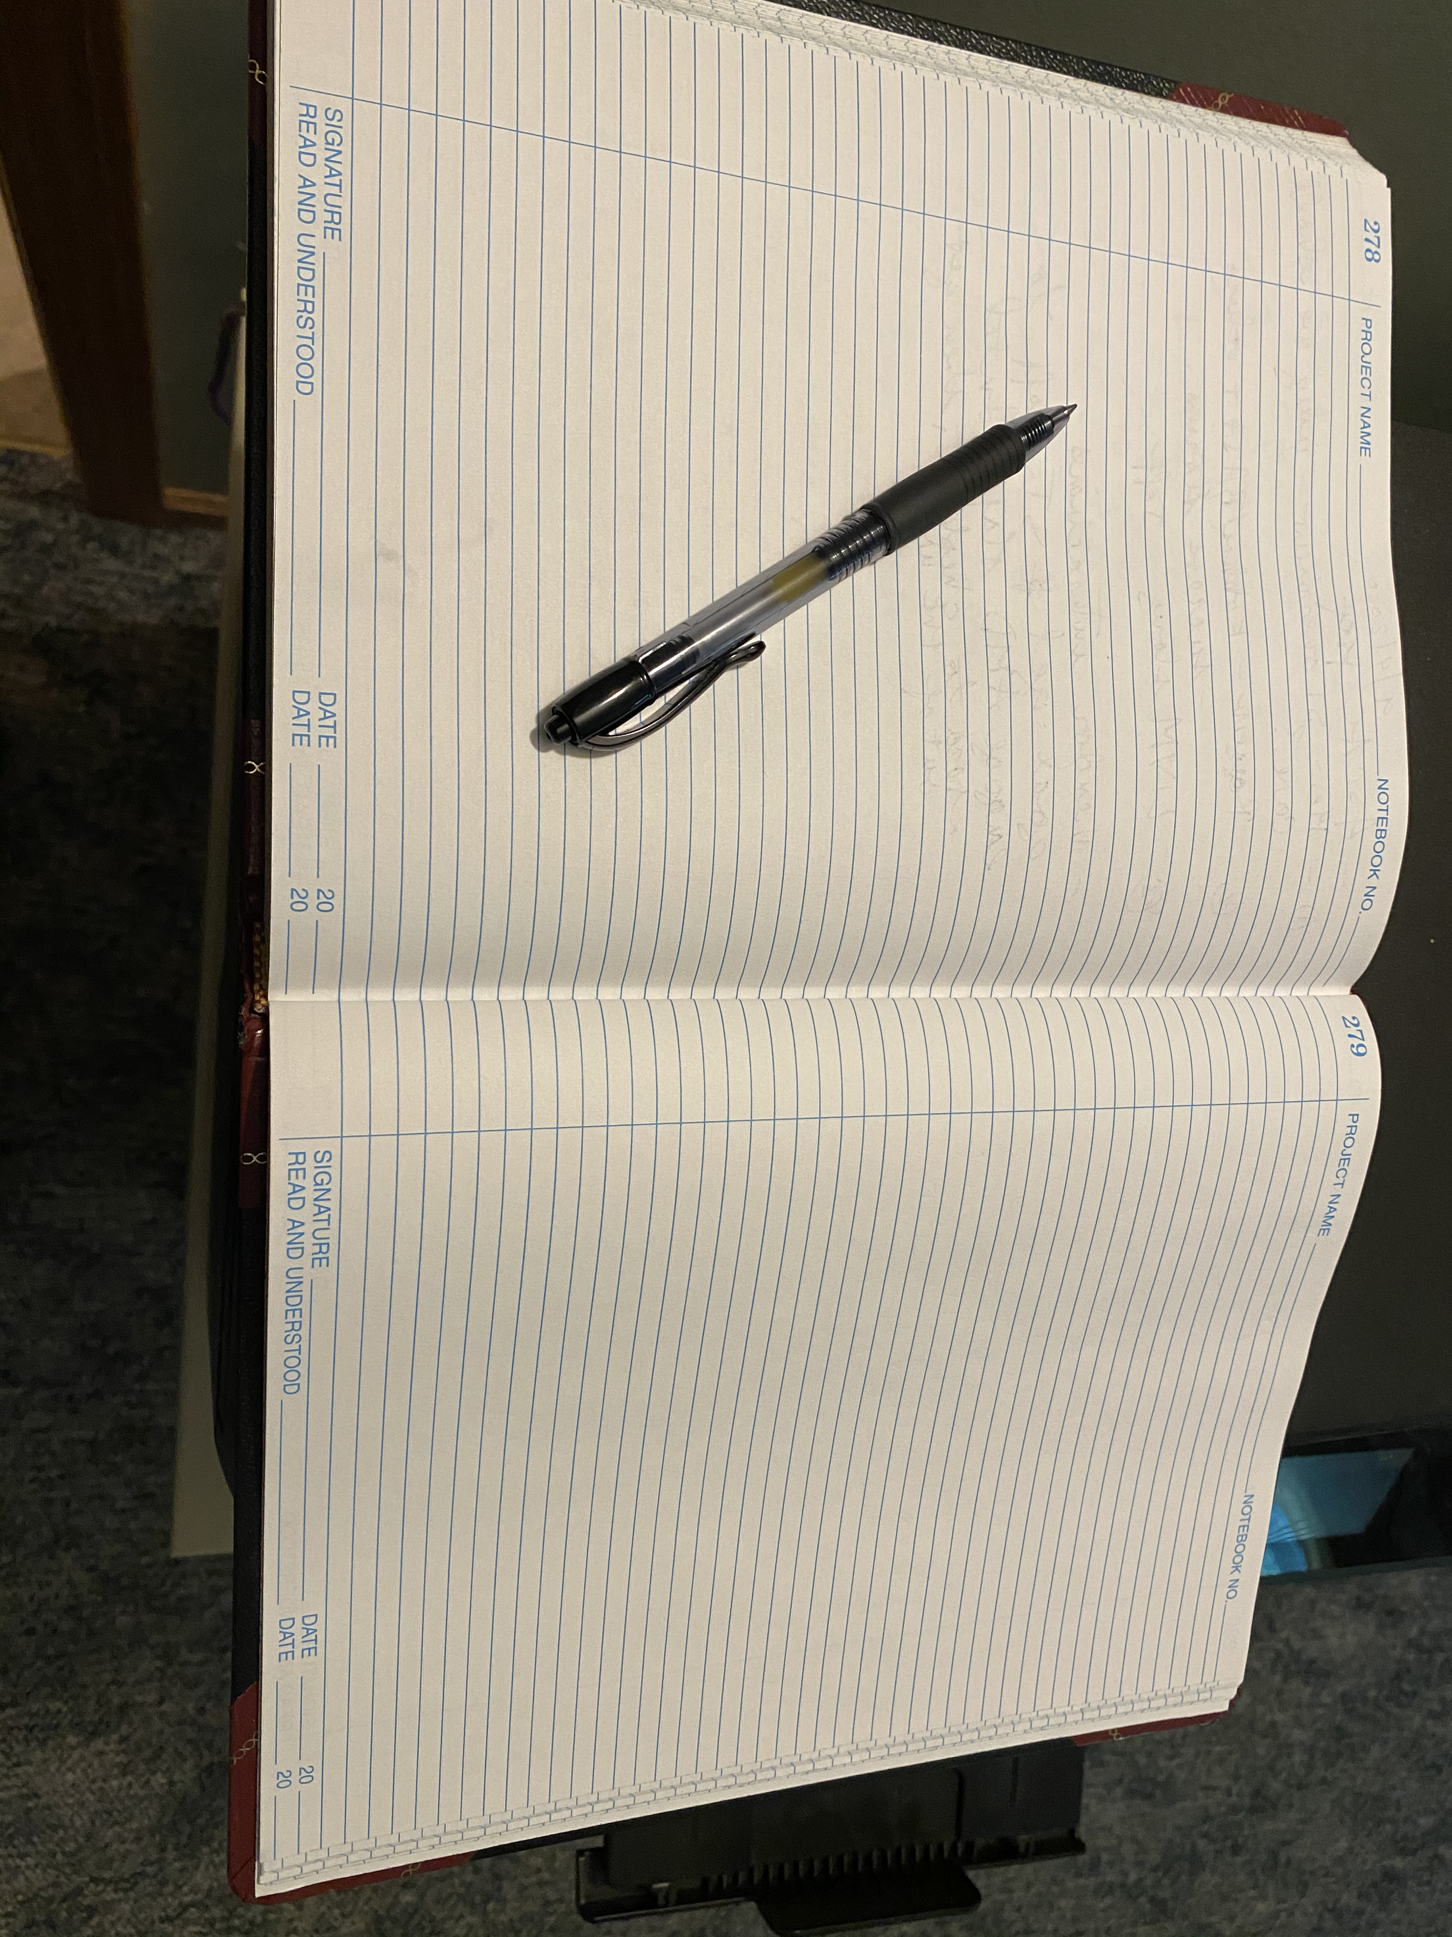
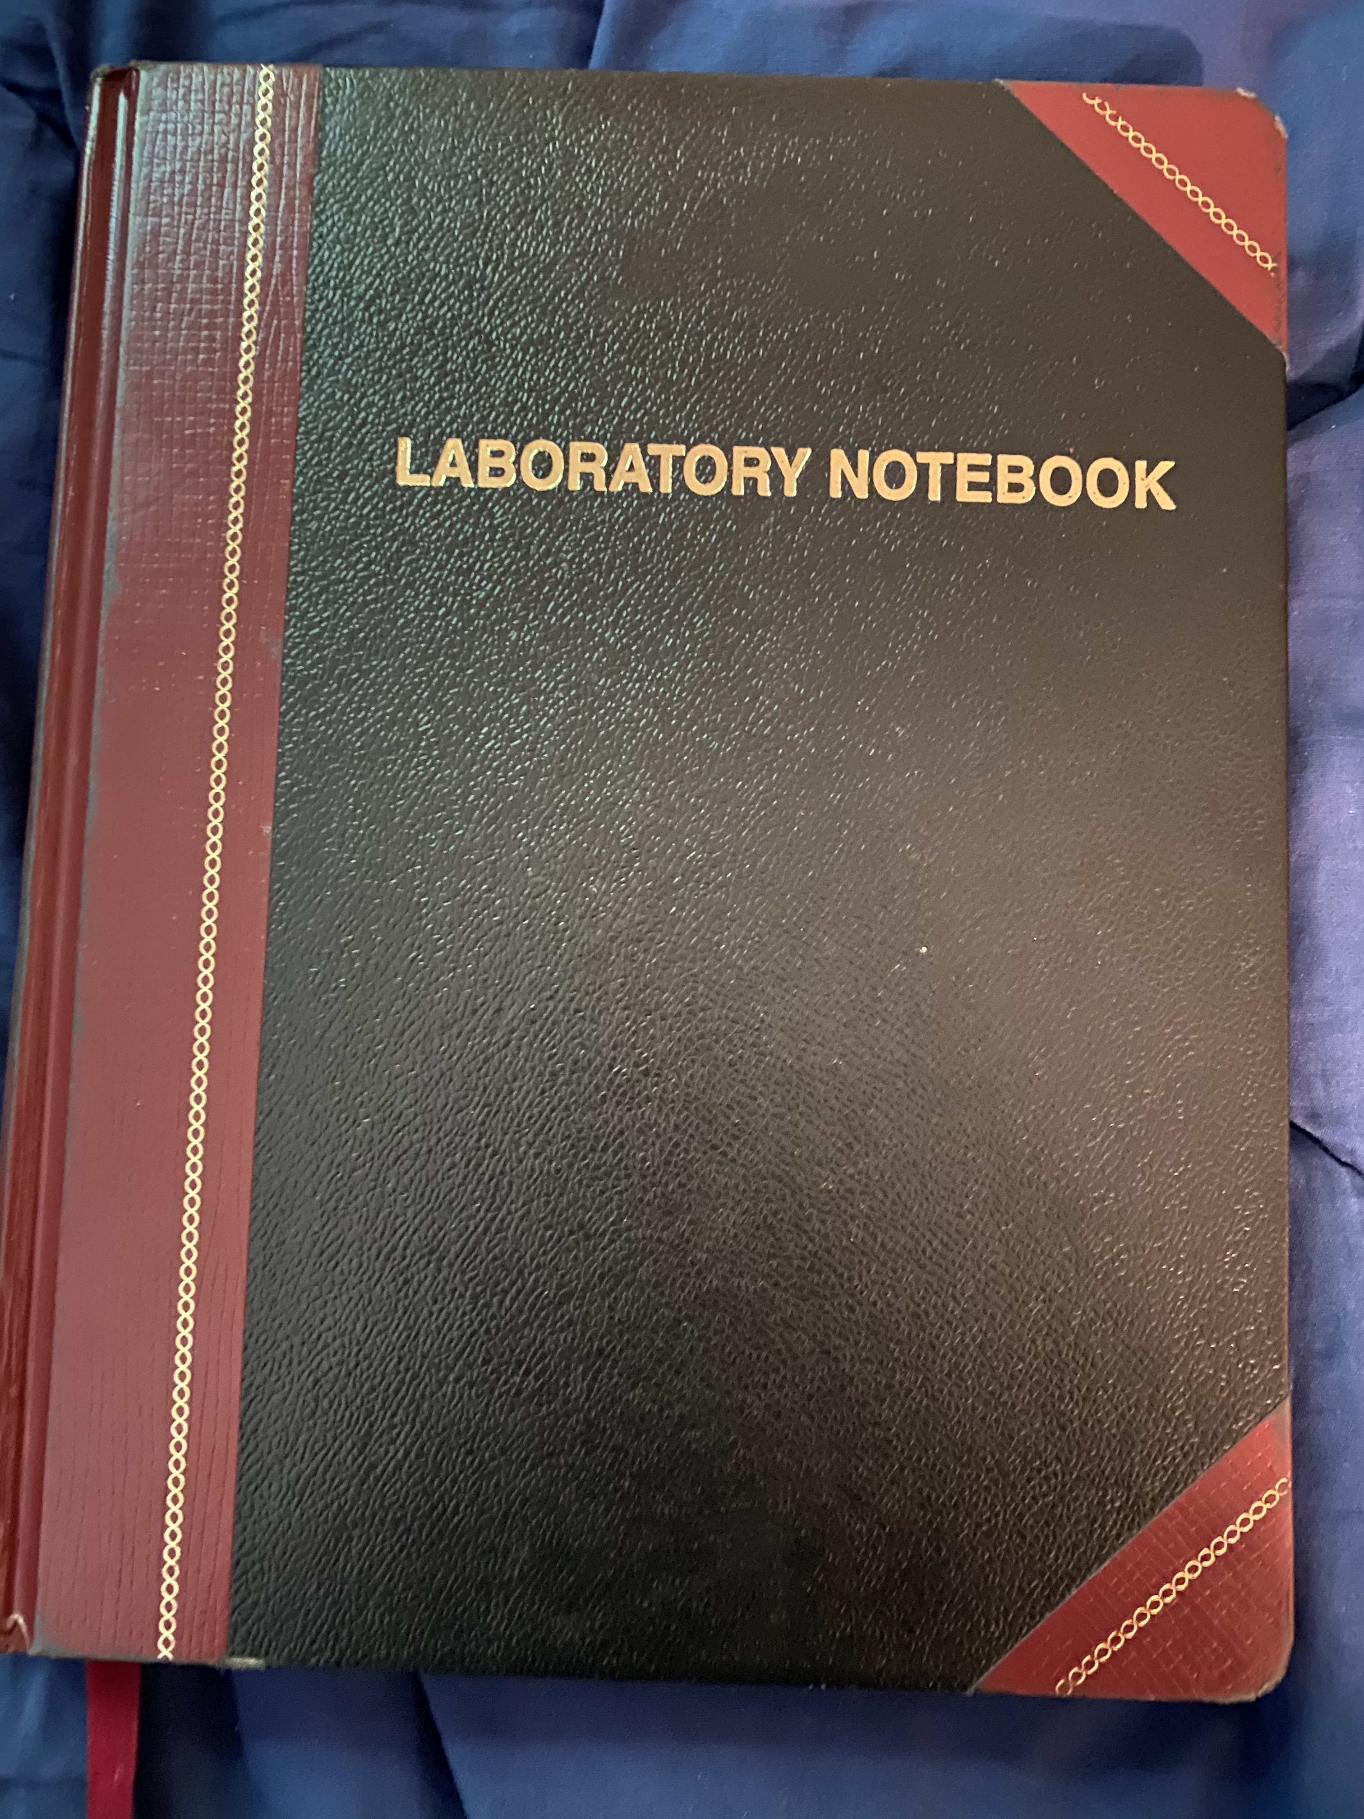
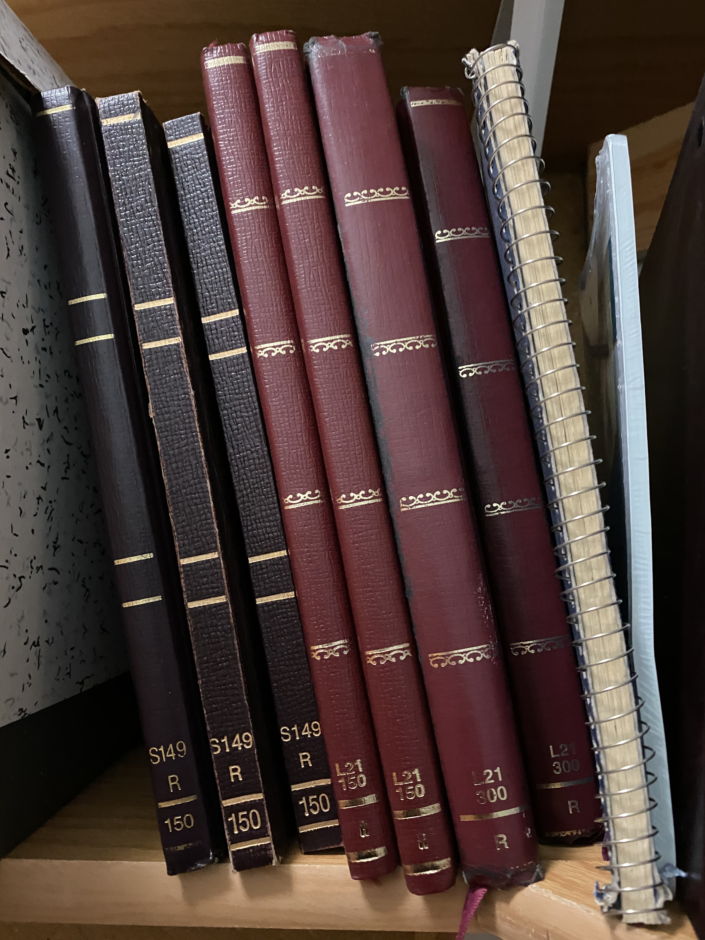

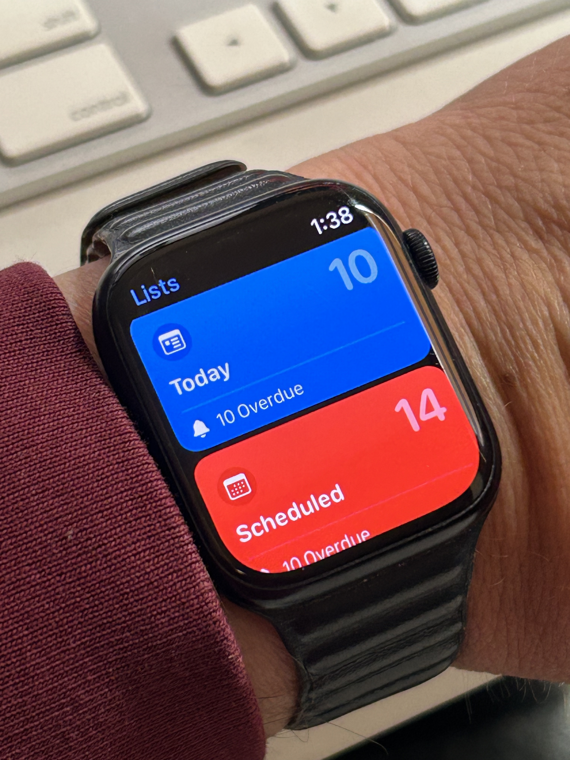
Notebook – Kanban Onramp
Knowledge is created on the edges:
Conversation between you and others
Reading, watching, listening to resources
Capture ideas in real time
Small pocket notebook & pen for “on the go”
Notebook for the workplace
Archived for looking back
Digital Options:
OneNote (Microsoft) – Great for conferences, blending images and notes
Evernote – Similar to OneNote
Simple text file – Most flexible and resilient digital option
Smart watch
Next: All these great ideas. How to manage? Kanban!

Slide 5
Kanban principles
Limit number of “In Progress” tasks
Productivity improvement:
Optimize “flexibility vs swap overhead” balance. No overcommitting.
Productivity weakness exposed as bottleneck. Team must identify and fix the bottleneck.
Effective in R&D setting. Avoids a deadline- based approach. Deadlines are dealt with in a different way.
Provides a board for viewing and managing issues
Task: Have Eureka moment by Tuesday.

Slide 6
Basic Kanban
Backlog | Ready | In Progress | Done
Any task idea Trim occasionally Source for other columns | Task + description of how to do it. Could be pulled when slot opens. Typically comes from backlog. | Task you are working on right now. The only Kanban rule: Can have only so many “In Progress” tasks. Limit is based on experience, calibration. Key: Work is pulled. You are in charge! | Completed tasks. Record of your life activities. Rate of completion is your “velocity”.
Notes:
Ready column is not strictly required.
Other common column: In Review
Can be creative with columns:
Waiting on Supervisor Confirmation.

Slide 7
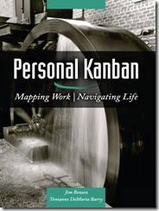
Personal Kanban
Personal Kanban: Kanban applied to one person.
Apply Kanban principles to your life.
Fully adaptable.
Personal Kanban: Commercial book/website.
Useful, but not necessary.
http://www.personalkanban.com

Slide 8
Kanban Tools
Wall, whiteboard, blackboard: Basic approach.
Software, cloud-based:
Trello, JIRA, GitHub Issues.
Many more.
I use Trello (browser, iPhone, iPad).
Can add, view, update, anytime, anywhere.
https://trello.com/b/04MQXyLo/personal-work-tasks

Slide 9
Big Question: How many tasks?
Personal question.
Approach: Start with a realistic list of what you are working on right now. See how it goes.
Use a freeway traffic analogy:
Does traffic flow best when fully packed? No.
Same thing with your effectiveness.
Spend time consulting board regularly.
Brings focus.
Enables reflection, retrospection.
Use slack time effectively.

Slide 10
Create a Kanban Board
Go to https://github.com/<GitHubID>
Click on Projects Tab
Select New Project
Select “Board” option
Result: First Kanban board!

Slide 11
Time Multipliers
Kanban assists you with these principles:
Commit some time to Important but not Urgent.
Be done-done.
Leave breadcrumbs.
Complementary multi-tasking.
Leave slack in your schedule.
Not this one:
Work with synergistic people.

Slide 12
Importance of “In Progress” Concept for you
Junior community members:
Less control over task.
Given by supervisor.
In Progress column: Protects you.
If asked to take on another task, respond:
Is this important enough to become less efficient?
Sometimes it is.

Slide 13
(Personal) Productivity++ Initiative Ask: Is My Work _______ ?
https://github.com/trilinos/Trilinos/wiki/Productivity---Initiative

Slide 14
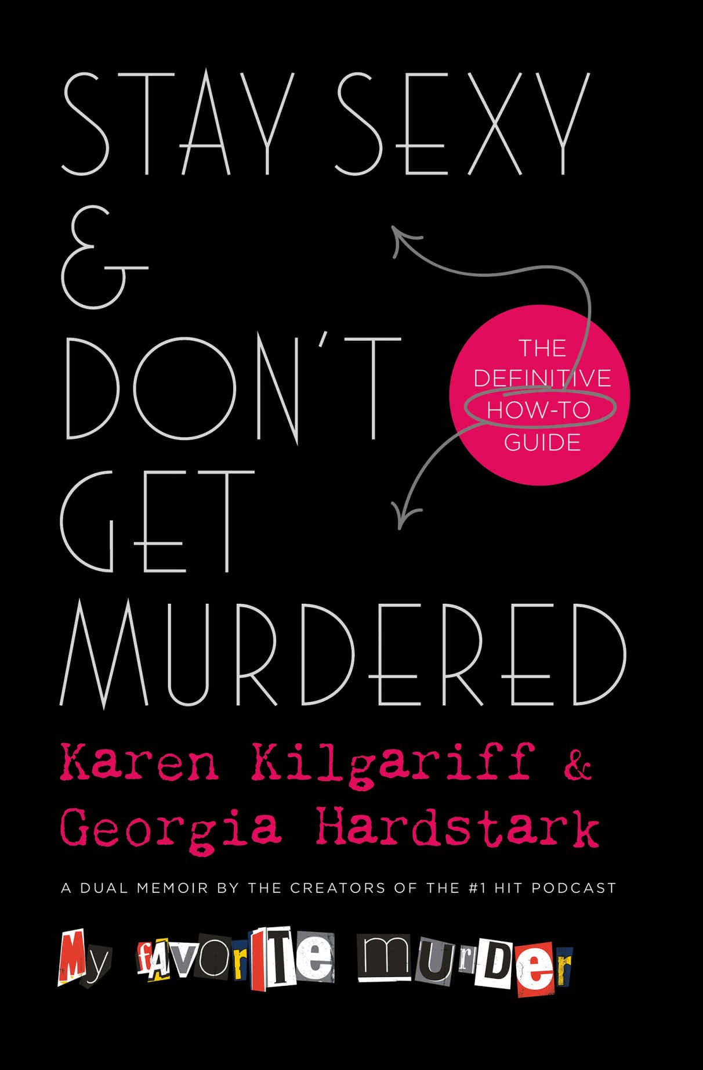

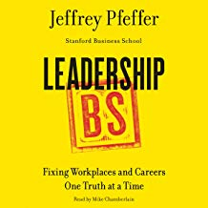
Complementary Multi-tasking.

Slide 15
Your Digital Presence
Michael A. Heroux
Scientist in Residence
Department of Computer Science
Sandia National Laboratories is a multi-program laboratory operated by Sandia Corporation, a wholly owned subsidiary of Lockheed Martin company, for the U.S. Department of Energy’s National Nuclear Security Administration under contract DE-AC04-94AL85000.

Slide 16
Digital Platforms for Communication
REMINDER: Free digital platforms are:
Free as in no out-of-pocket expense, or ”freemium” (pay for some features).
NOT free as no-cost:
Your information (usually anonymized) is mined and used.
When paired with other information outside the system, can quickly and uniquely identify you.
Takeaway: Be careful what you share, or if you share at all.
Having said that:
These platforms are useful for making others aware of you, your projects.
They are indispensable for distributed collaboration. Just be careful with sharing scope.

Slide 17
LinkedIn
Professional Networking Site.
Owned by Microsoft.
Used for professional news, recruiting, community stature.
Skills and Endorsements.
A professional version of FaceBook.

Slide 18
GitHub
GitHub is an information management and collaboration platform.
It is useful for software projects (you know this) and much more (you may not know this).
Formatted documents: Markdown - https://www.markdownguide.org/cheat-sheet/
Types of organizations:
You (your GitHub ID):
maherou – mine
https://maherou.github.io – My website
https://github.com/maherou – Uses a newer GitHub profile repo – Enables configurable README.md
Others:
BetterScientificSoftware: Org for advancing, well, better scientific software.
Multiple repos: PSIP-Tools, Trust-Tools.
Special repo: https://betterscientificsoftware.github.io
Collegeville: Educational org
https://github.com/Collegeville
Research student repos.
Project repos.
Issues-only repo: https://github.com/Collegeville/Labora
Team policy: https://github.com/Collegeville/Labora/blob/master/TeamPolicy.md
Workshop repos: https://github.com/Collegeville/Workshops
Generated website: https://collegeville.github.io/Workshops/

Slide 19
AI and You
Michael A. Heroux
Scientist in Residence
Department of Computer Science

Slide 20
Powerful Questions
Kids to Adults: Why? Why? Why?
You to AI Bot: How? How? How?
Prompt:
I <describe your job>. How can you help me do my job better?

Slide 21
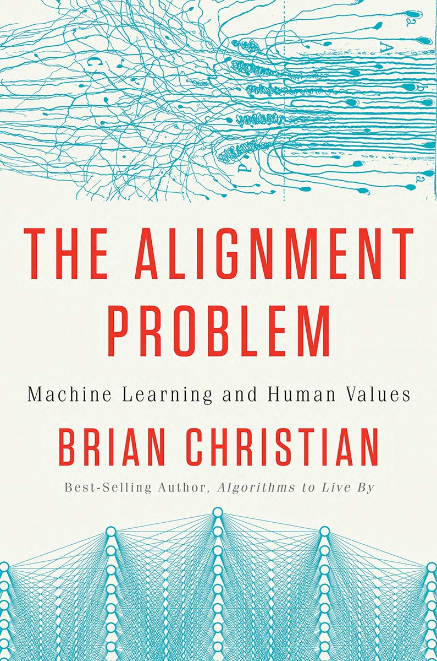
AI and Alignment
Course Book
AI enables the creation of powerful tools
The consequences of design choices are much higher
Key concept: Alignment
Increased demand:
Domain knowledge: What the tools are supposed to do
Human knowledge: Understanding humans, our needs, how to design

Slide 22
Automation Anxiety: Will AI Replace Me?
April 24, 1907, NYC lamplighters strike: 25,000 lamps went unlit
No lamplighters today
AI will not replace you
You+AI will replace you
Consciousness is the way information feels as we process it.
Demis Hassabis, Google DeepMind, 2024 Nobel Prize Winner in Chemistry

Slide 23
Lessons from the Industrial Revolution
It wasn’t the steam engine alone that caused the Industrial Revolution. It was the thousands of specific machines invented by skilled craftsmen that used steam to augment or do existing work that created the Revolution.
Ethan Mollick
Reading Recommendation: One Useful Thing https://www.oneusefulthing.org
Blog by Ethan Mollick

Slide 24
Your Own Personal Writing Team
Authoring
Brainstorm topics
Generate outline
Recursively provide more detail
Assessment
Request AI review of content
Improvement
Steel-manning other perspectives
Refine content – understandable by a novice, TL;DR, etc.
Corporate executives have a writing team; now you do, too!

Slide 25
AI Summary
AI is changing everything: Yes, I know this sounds grandiose, but I believe it
Helping with tedious tasks
Upscaling our technical skills
Fundamentally reshaping the research enterprise
Some impacts:
Many mechanical skills and activities are being automated
The importance of soft skills is increasing, alignment is why
Scientific progress will be limited by imagination

Slide 26
Final Thoughts on AI
Generative AI Tools are transforming the workplace and R&D
Many of our mechanical tasks can automated or accelerated
Our competitiveness as an R&D organization means we need to learn these tools
Any job can be made productive, especially the mundane tasks
The industrial revolution succeeded by the work of thousands of people
Success with AI will be the same
We are the key to success
You+AI will replace You
26

Slide 27
High points
Time is precious: Manage it well, even in this early phase of your life.
Structure your life so you are effective (character) and efficient (competent).
Always improve: Build habits so learning is naturally part of your life.
Seek diverse content: Needed for big picture thinking.
Establish (or not) your online presence.

Slide 28
Challenge One
Establish a personal note taking system
How will you capture ideas that emerge in real time?
How can you capture visual and text content?

Slide 29
Challenge Two
Establish a work management platform
Will Kanban work for you?
Something else?
What tools?

Slide 30
Challenge Three
Create your own GitHub pages website:
Start from an existing site you like:
Fork it
Rename it to github-id.github.io (example maherou.github.io)
Clone it (recommend using GitHub Desktop Client)
Edit using:
GitHub web-based editor (for small changes or creating a new file)
VS Code (my favorite Markdown editor)
Commit back to main GitHub repo
Make sure GitHub pages features are enabled for the repo in Settings
Wait for it to compile (automatically done using Jekyll)
View the site at https://github-id.github.io

Slide 31
Challenge Four
Create a LinkedIn account
Add bio, experience, interests
Invite people to connect (you can invite me, I will accept)
Consider doing skills tests, getting recommendations, …

Slide 32
Challenge Five
Invest in learning how to use generative AI tools
Be creative, make AI your intellectual companion
Create a collection of advisory personas: Your personal team
You and AI are better than you alone

